Slide 1

METABOLANDER:
Cardiometabolic Disease Risk Predictor
Maggie Cook, Alyssa Easton, Paul Kim, Kira Olander, Mattias Tolhurst
Created using data courtesy of

Slide 2
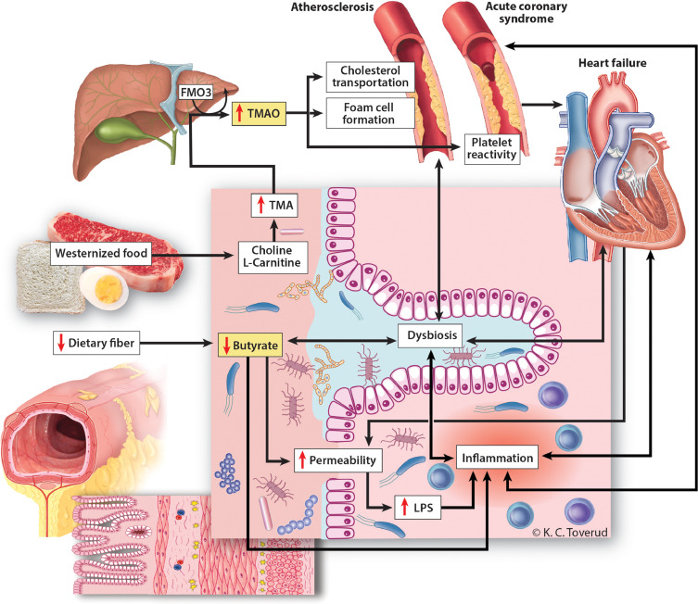
Gut-Heart Axis
Gut-heart interactions mediated by blood metabolites and proteins
Heart disease has a microbiome and metabolome signature
Multi-omics data reveals biomarkers, providing a premise for mechanistic models
Gut microbiome could be a therapeutic target for heart disease
Trøseid, M., Andersen, G. Ø., Broch, K., & Hov, J. R. (2020). The gut microbiome in coronary artery disease and heart failure: Current knowledge and future directions. EBioMedicine, 52, 102649.
Notes:
Alyssa: Heart disease is accompanied by dysfunction of the gut microbiome. Recent studies have shown that this relationship is a complex feedback loop mediated by metabolites in the bloodstream. Multi-omics data from large cohorts studies can help us identify biomarkers, providing a premise for mechanistic models and hypotheses. The gut microbiome is specifically of interest as a therapeutic target for heart disease because the composition (and thus the metabolites it produces) can be altered via diet.

Slide 3
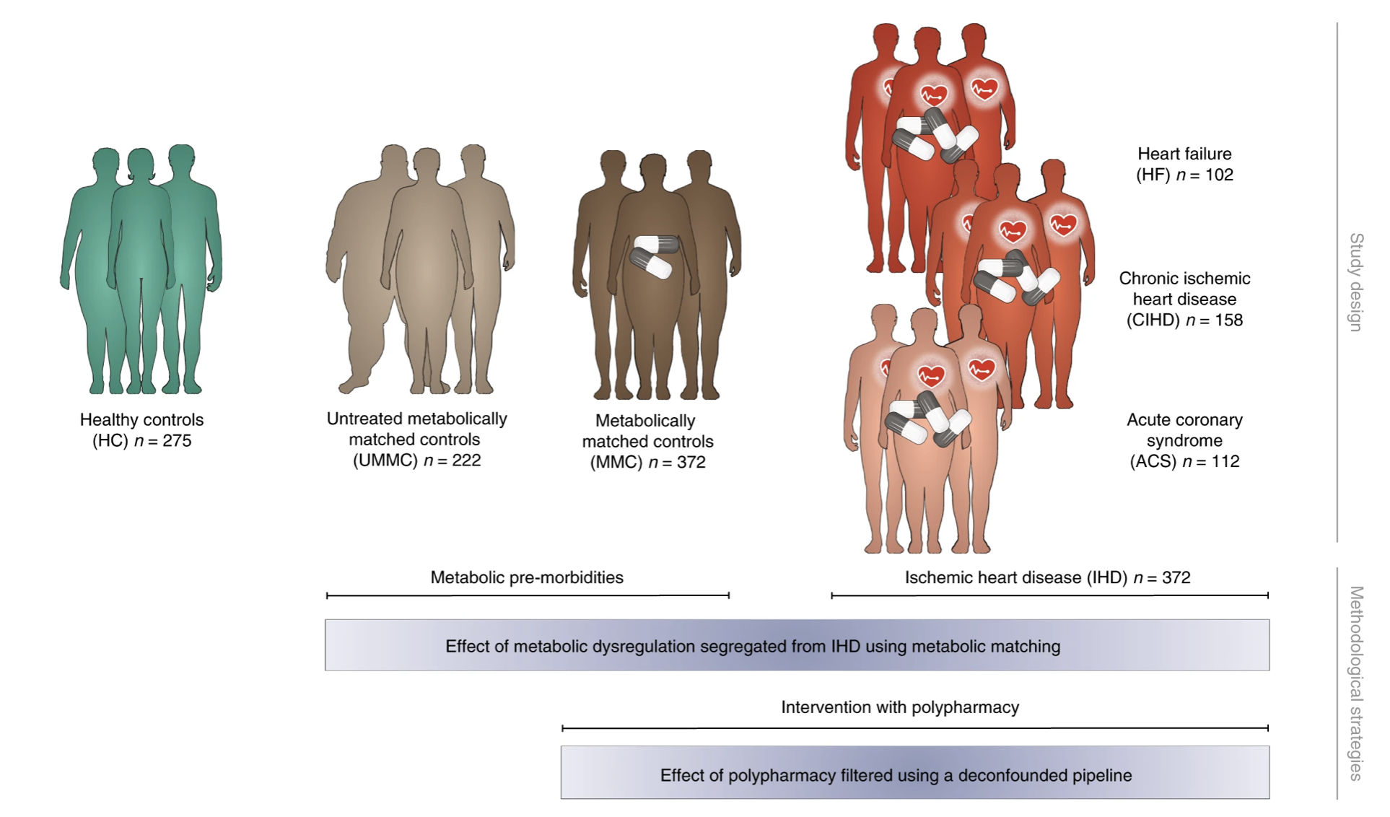
Data Collection
Fromentin, S., Forslund, S.K., Chechi, K. et al.
Notes:
Alyssa: The data we analyze here comes from the European MetaCardis cohort. Subgroups include healthy controls, heart disease patients being treated, and controls not diagnosed with heart disease, but metabolically matched to heart disease patients, treated or untreated. This study identified biomarkers of heart disease in the microbiome/metabolome, and saw that about 75% of the features that distinguish individuals with IHD from healthy individuals after adjustment for effects of medication and lifestyle are present in individuals exhibiting dysmetabolism, suggesting that major alterations of the gut microbiome and metabolome might begin long before clinical onset of IHD. We decided to use their publicly available data to create a ML tool that predicts heart disease risk for an individual from only basic demographic information, microbiome, and blood metabolome features.

Slide 4
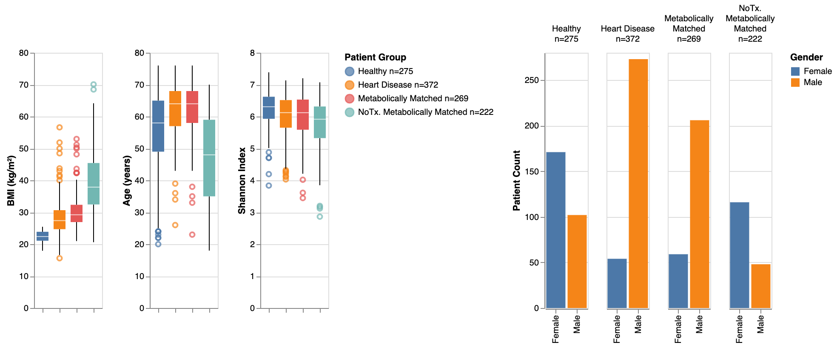
Data Exploration, Cohort Characterization

Slide 5
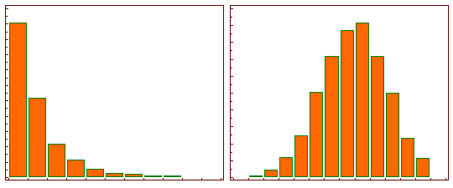
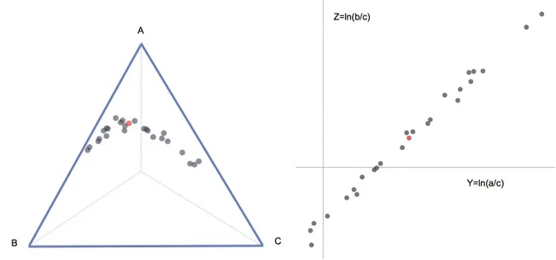
Data Preprocessing
Metabolites log-transformed
Microbe counts ratios CLR transformed

Slide 6
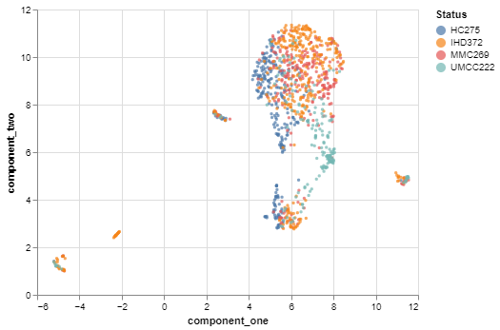
Data Clustering
All Features
Relatively distinct groups
Unmedicated metabolically matched controls seems very isolated - they also have different demographics from the average

Slide 7
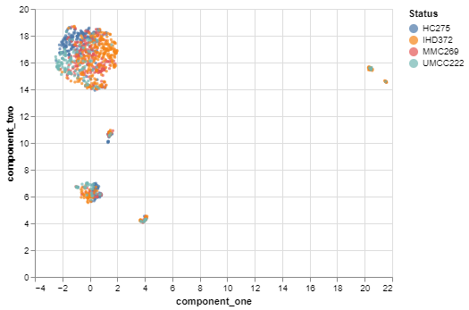
Data Clustering
Only Bacteria and Metabolites
Still seeing distinct groups
Unmedicated metabolically matched controls less isolated removing demographic variables
More obvious “islands”

Slide 8
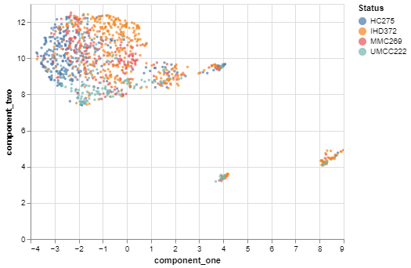
Data Clustering
Only Highly Variable Bacteria
and Metabolites
Fewer islands and able to retain distinct clusters, with all but medicated metabolically matched controls
It is known that medications can mask biomarkers

Slide 9
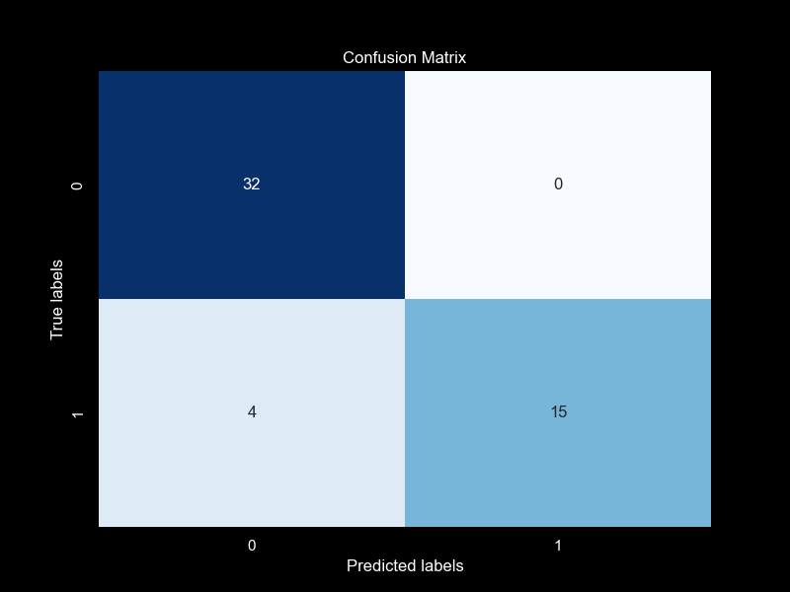
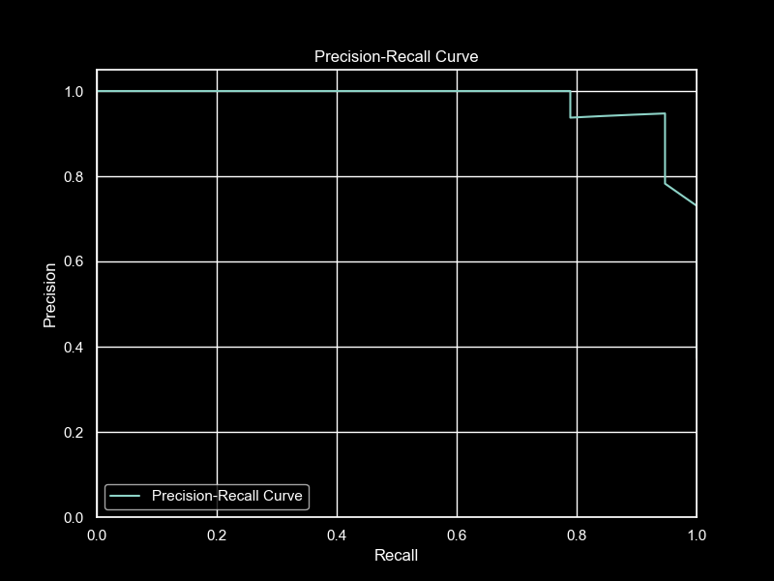
Modeling
Reduced number of features
Univariate F-test
RFE-CV with logistic regression
Final model is RF
Hyperparameter search for optimal n_trees
Best forest - n_trees=250
Final test set performance:
Accuracy: 0.92
Precision: 1.0
Recall 0.79

Slide 10


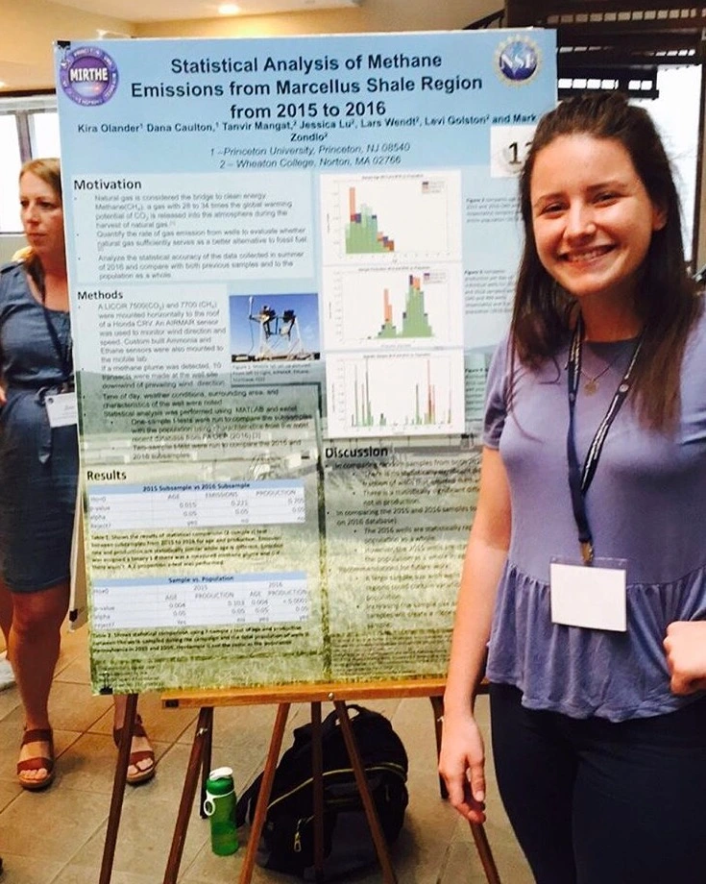



Inspired By.
References:
Fromentin, S., Forslund, S.K., Chechi, K. et al. Microbiome and metabolome features of the cardiometabolic disease spectrum. Nat Med 28, 303–314 (2022). https://doi.org/10.1038/s41591-022-01688-4
Trøseid, M., Andersen, G. Ø., Broch, K., & Hov, J. R. (2020). The gut microbiome in coronary artery disease and heart failure: Current knowledge and future directions. EBioMedicine, 52, 102649.

